Slide 1

PRODUCT SEARCH
Project & Slides Created by:
Edward Andino Sierra
Carlos Mendoza
Ivan Zelenkov

Slide 2

THE APP’S FEATURES
An app that displays the ID, Brand, ModelNumber, ModelYear, ProductName, and Description of multiple products stored in a database.
A search bar allows the user instantly search for any product that has any combination of letters with its tuples in common with the search result.
The search essentially filters the data as the user types in the search bar; no need for typing and pressing enter.
Before the search results are displayed, they are sorted.
Merge Sort and Binary Search were implemented in order to create an efficient running time.

Slide 3
TIMELINE
Work began on a more efficient JavaFX app using MySQL localhost server to retrieve data.
Planning out communication, file sharing, getting a base idea.
FEB
MAR
APR
Originally planned to be a Java web app using Apache. Implementing Sort and Search in a servlet file proved to be difficult.
Final Touches. Potentially analyzing run time in more detail.

Slide 4





LANGUAGES AND SOFTWARE USED
JavaFX is a set of graphics and media packages that enables developers to design, create, test, debug, and deploy rich client applications that operate consistently across diverse platforms.
Scene Builder allows the easy layout of JavaFX UI controls, charts, shapes, and containers so that you can quickly prototype user interfaces.
MySQL Server is used to add, delete, and modify data stored in the application.
IntelliJ IDEA Ultimate is designed for full-stack and enterprise development, supporting a wide range of backend and frontend frameworks and technologies. It includes profiling and database tools, an HTTP client, and many more features for professional developers out of the box.

Slide 5
Divide and Conquer Strategy
Using the Divide and Conquer technique, we divide a problem into subproblems. When the solution to each subproblem is ready, we 'combine' the results from the subproblems to solve the main problem.
Divide
If q is the halfway point between p and r, then we can split the subarray A[p..r] into two arrays A[p..q] and A[q+1, r].
Conquer
In the conquer step, we try to sort both the subarrays A[p..q] and A[q+1, r]. If we haven't yet reached the base case, we again divide both these subarrays and try to sort them.
Combine
When the conquer step reaches the base step and we get two sorted subarrays A[p..q] and A[q+1, r] for array A[p..r], we combine the results by creating a sorted array A[p..r] from two sorted subarrays A[p..q] and A[q+1, r].
MERGE SORT

Slide 6
MERGE SORT
public static void mergeSort(int[] a, int n) {
if (n < 2) {
return;
}
int mid = n / 2;
int[] l = new int[mid];
int[] r = new int[n - mid];
for (int i = 0; i < mid; i++) {
l[i] = a[i];
}
for (int i = mid; i < n; i++) {
r[i - mid] = a[i];
}
mergeSort(l, mid);
mergeSort(r, n - mid);
merge(a, l, r, mid, n - mid);
}
public static void merge( int[] a, int[] l, int[] r, int left, int right) {
int i = 0, j = 0, k = 0;
while (i < left && j < right) {
if (l[i] <= r[j]) {
a[k++] = l[i++];
} else {
a[k++] = r[j++];
}
}
while (i < left) {
a[k++] = l[i++];
}
while (j < right) {
a[k++] = r[j++];
}
}

Slide 7
MERGE SORT
8
2
9
4
5
3
1
6
8 2 9 4
5 3 1 6
When solved, the time complexity will come to O(N log N)
This is true for the worst, average and best case since it will always divide the array into two and then merge.
The space complexity of the algorithm is O(N) as we're creating temporary arrays in every recursive call.
Divide
8 2
9 4
5 3
1 6
Divide
8 2 9 4 5 3 1 6
1 element
Merge
2 8 4 9 3 5 1 6
Merge
2 4 8 9 1 3 5 6
Merge
1 2 3 4 5 6 8 9

Slide 8
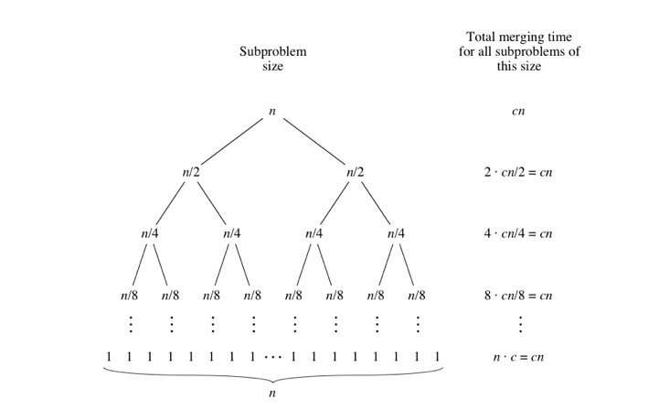
Analysis of merge sort
l = log2 n +1
cn = n/subproblems
Total time cn(log2n+1) = O(nlog2 n)
Notes:
L = log 2 (3000) +1 = 12.5
Cn = 3000 / (5793) = 0.522

Slide 9
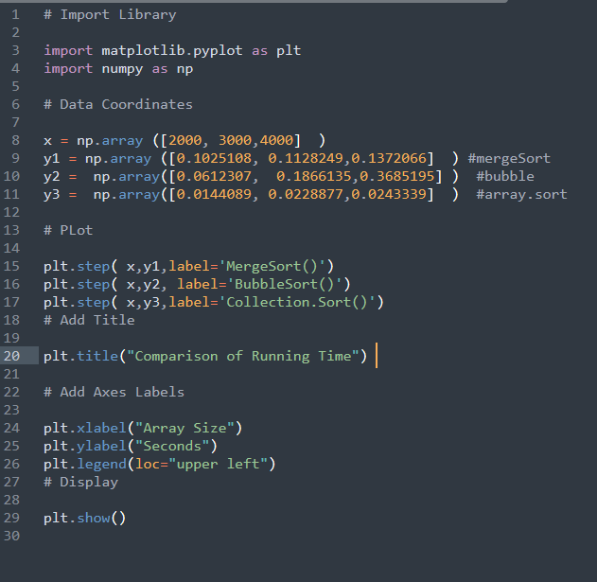
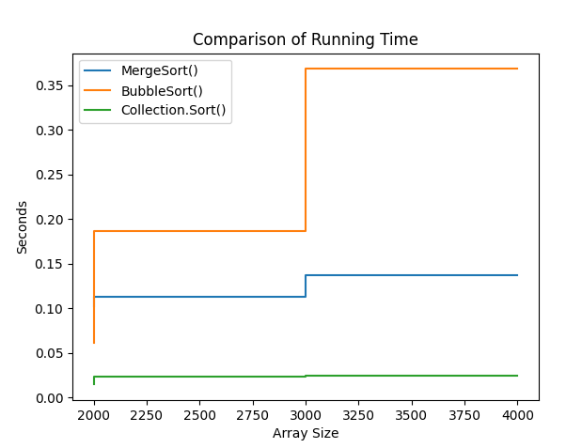
Using Matplotlib

Slide 10
Arrays.sort() and Collections.sort()
Arrays.sort uses two sorting algorithms. One is a modification of Quicksort named dual-pivot quicksort, the other an adaptation of MergeSort named Timsort. Both have a time complexity of O(n log n), where n is the total number of items in the array.
The time complexity including the comparator is O(n * (log n) * c), where c is the time complexity of the comparator. By default, Arrays.sort uses a comparator following the natural ordering of the content for an O(1) time complexity. Programmer-defined comparators with little computational work also resolve to an O(1) time complexity.

Slide 11
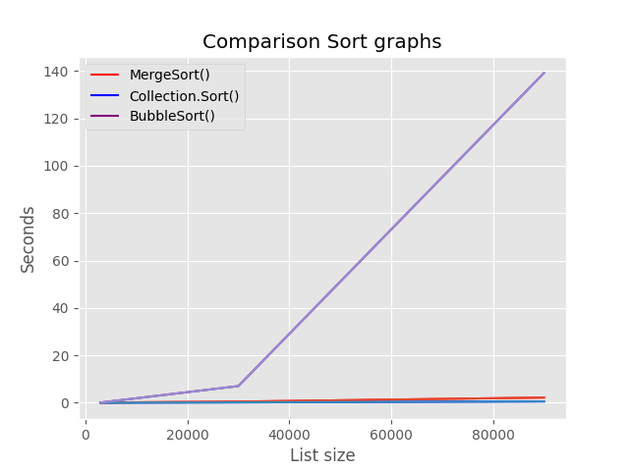
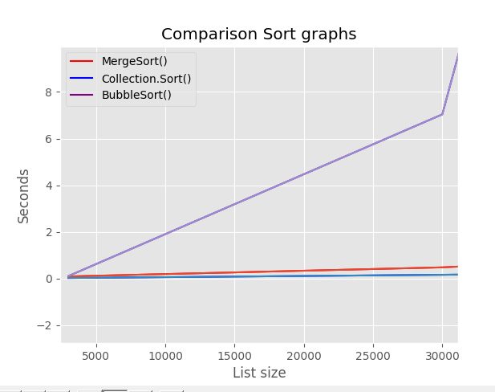
Comparison of Different Sorts

Slide 12
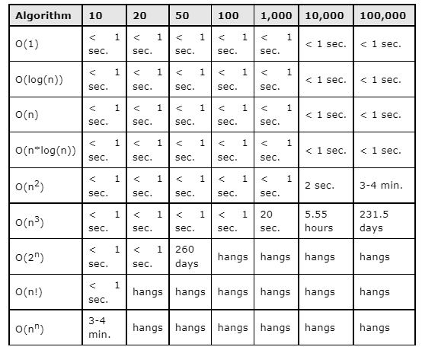
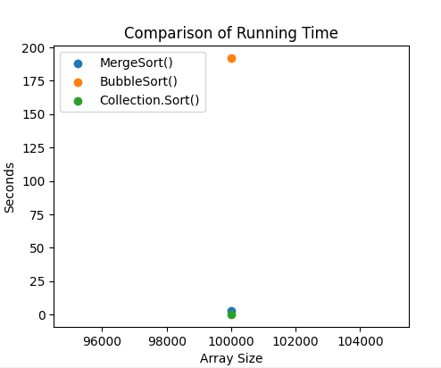
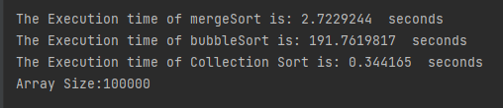
MergeSort()
Array.Sort()
BubbleSort()

Slide 13
Display code

Slide 14
BINARY SEARCH
Locates a target value in a sorted ArrayList by successively eliminating half of the array from consideration.
How many elements will it need to examine? O(log N)
Recursive binary search method, the space complexity would be O(log N)
Example: Searching the array below for the value 42.
index | 0 | 1 | 2 | 3 | 4 | 5 | 6 | 7 | 8 | 9 | 10 | 11 | 12 | 13 | 14 | 15 | 16
value | -4 | 2 | 7 | 10 | 15 | 20 | 22 | 25 | 30 | 36 | 42 | 50 | 56 | 68 | 85 | 92 | 103
min
mid
max

Slide 15
BINARY SEARCH CODE
// Returns the index of an occurrence of target in a,
// or a negative number if the target is not found.
// Precondition: elements of a are in sorted order
public static int binarySearch(int[] a, int target) {
int min = 0;
int max = a.length - 1;
while (min <= max) {
int mid = (min + max) / 2;
if (a[mid] < target) {
min = mid + 1;
} else if (a[mid] > target) {
max = mid - 1;
} else {
return mid; // target found
}
}
return -(min + 1); // target not found
}

Slide 16
BINARY SEARCH
Recursive binarySearch method.
If the target value is not found, return its negative insertion point.
index | 0 | 1 | 2 | 3 | 4 | 5 | 6 | 7 | 8 | 9 | 10 | 11 | 12 | 13 | 14 | 15 | 16
value | -4 | 2 | 7 | 10 | 15 | 20 | 22 | 25 | 30 | 36 | 42 | 50 | 56 | 68 | 85 | 92 | 103
int index = binarySearch(data, 42); // 10
int index2 = binarySearch(data, 66); // -14

Slide 17
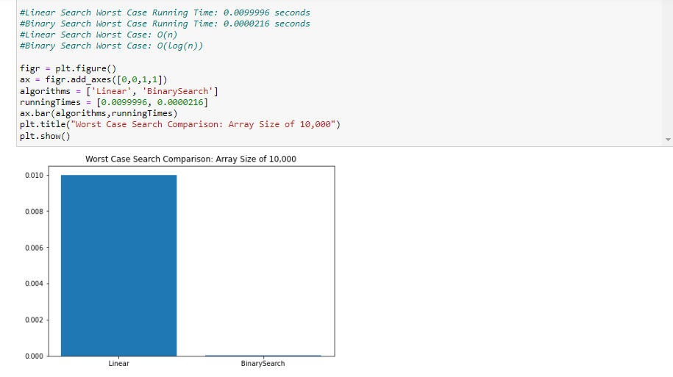
SEARCH ALGORITHM COMPARISON

Slide 18
RUNNING TIME FOR COMBINED ALGORITHMS
Merge Sort
Binary Search
Combining these algorithms results in a running time of O(N log(N)).
This means that the running time of Merge Sort and Binary combined is equivalent to just doing Merge Sort.
Combine
N * log(N)
log(N)
Remove Constants
N * log(N) + log(N)
N * log(N)

Slide 19
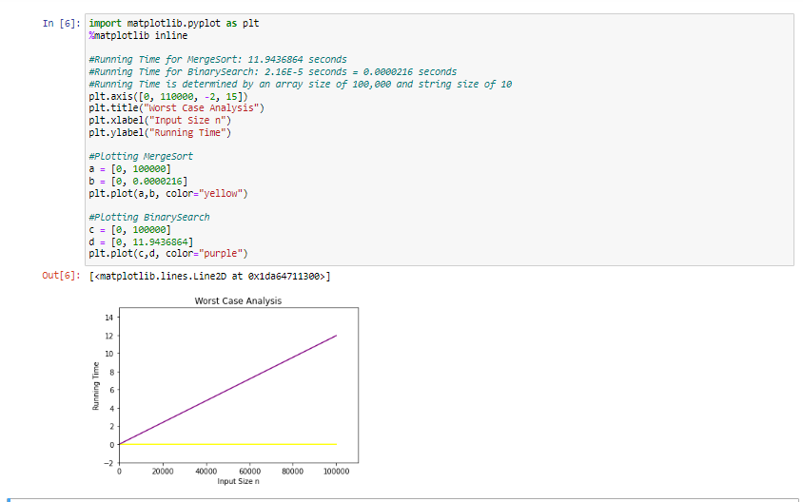
WORST(AND AVERAGE) CASE RUNNING TIME FOR COMBINED ALGORITHMS
11.9436864 + 0.0000216 is effectively still 11.94 seconds.

Slide 20
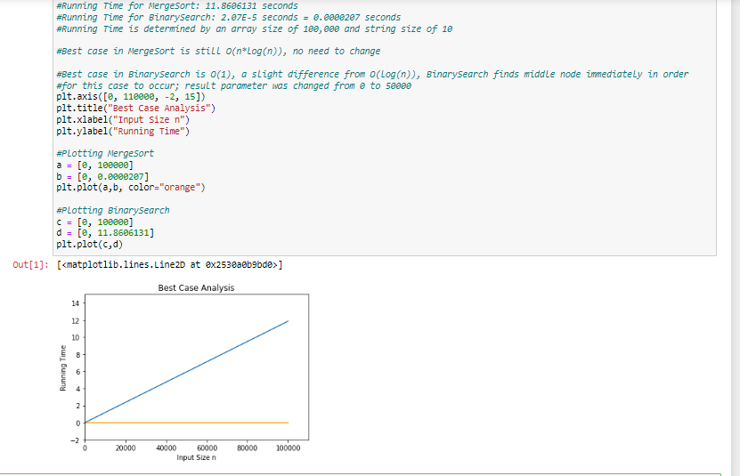
BEST CASE RUNNING TIME FOR COMBINED ALGORITHMS

Slide 21

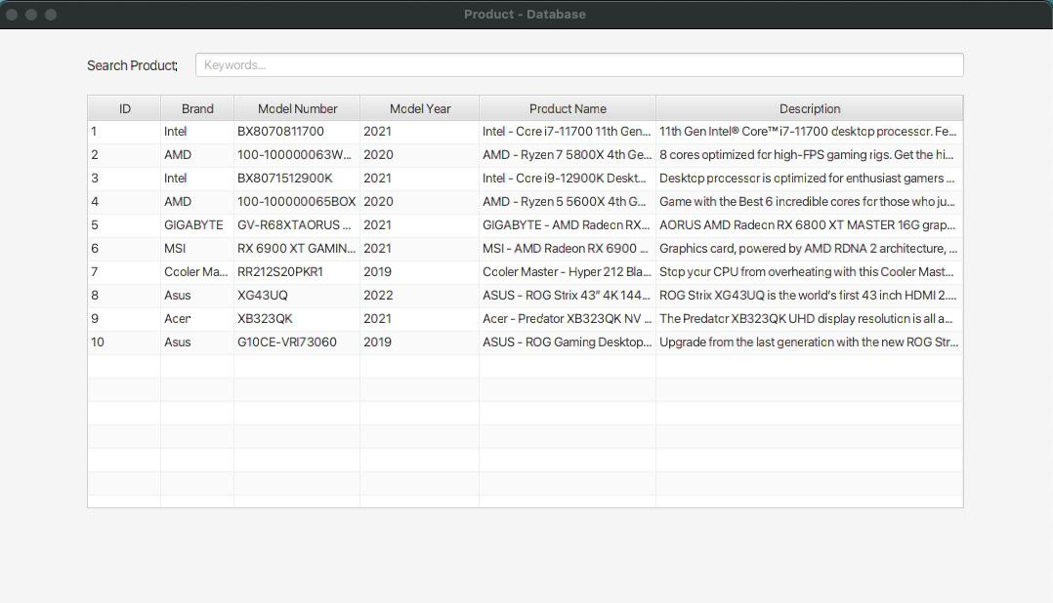
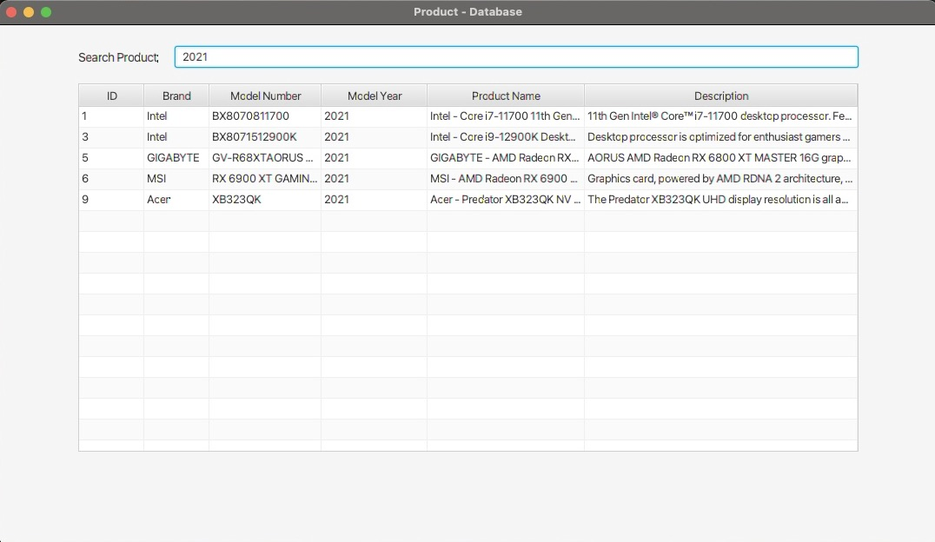
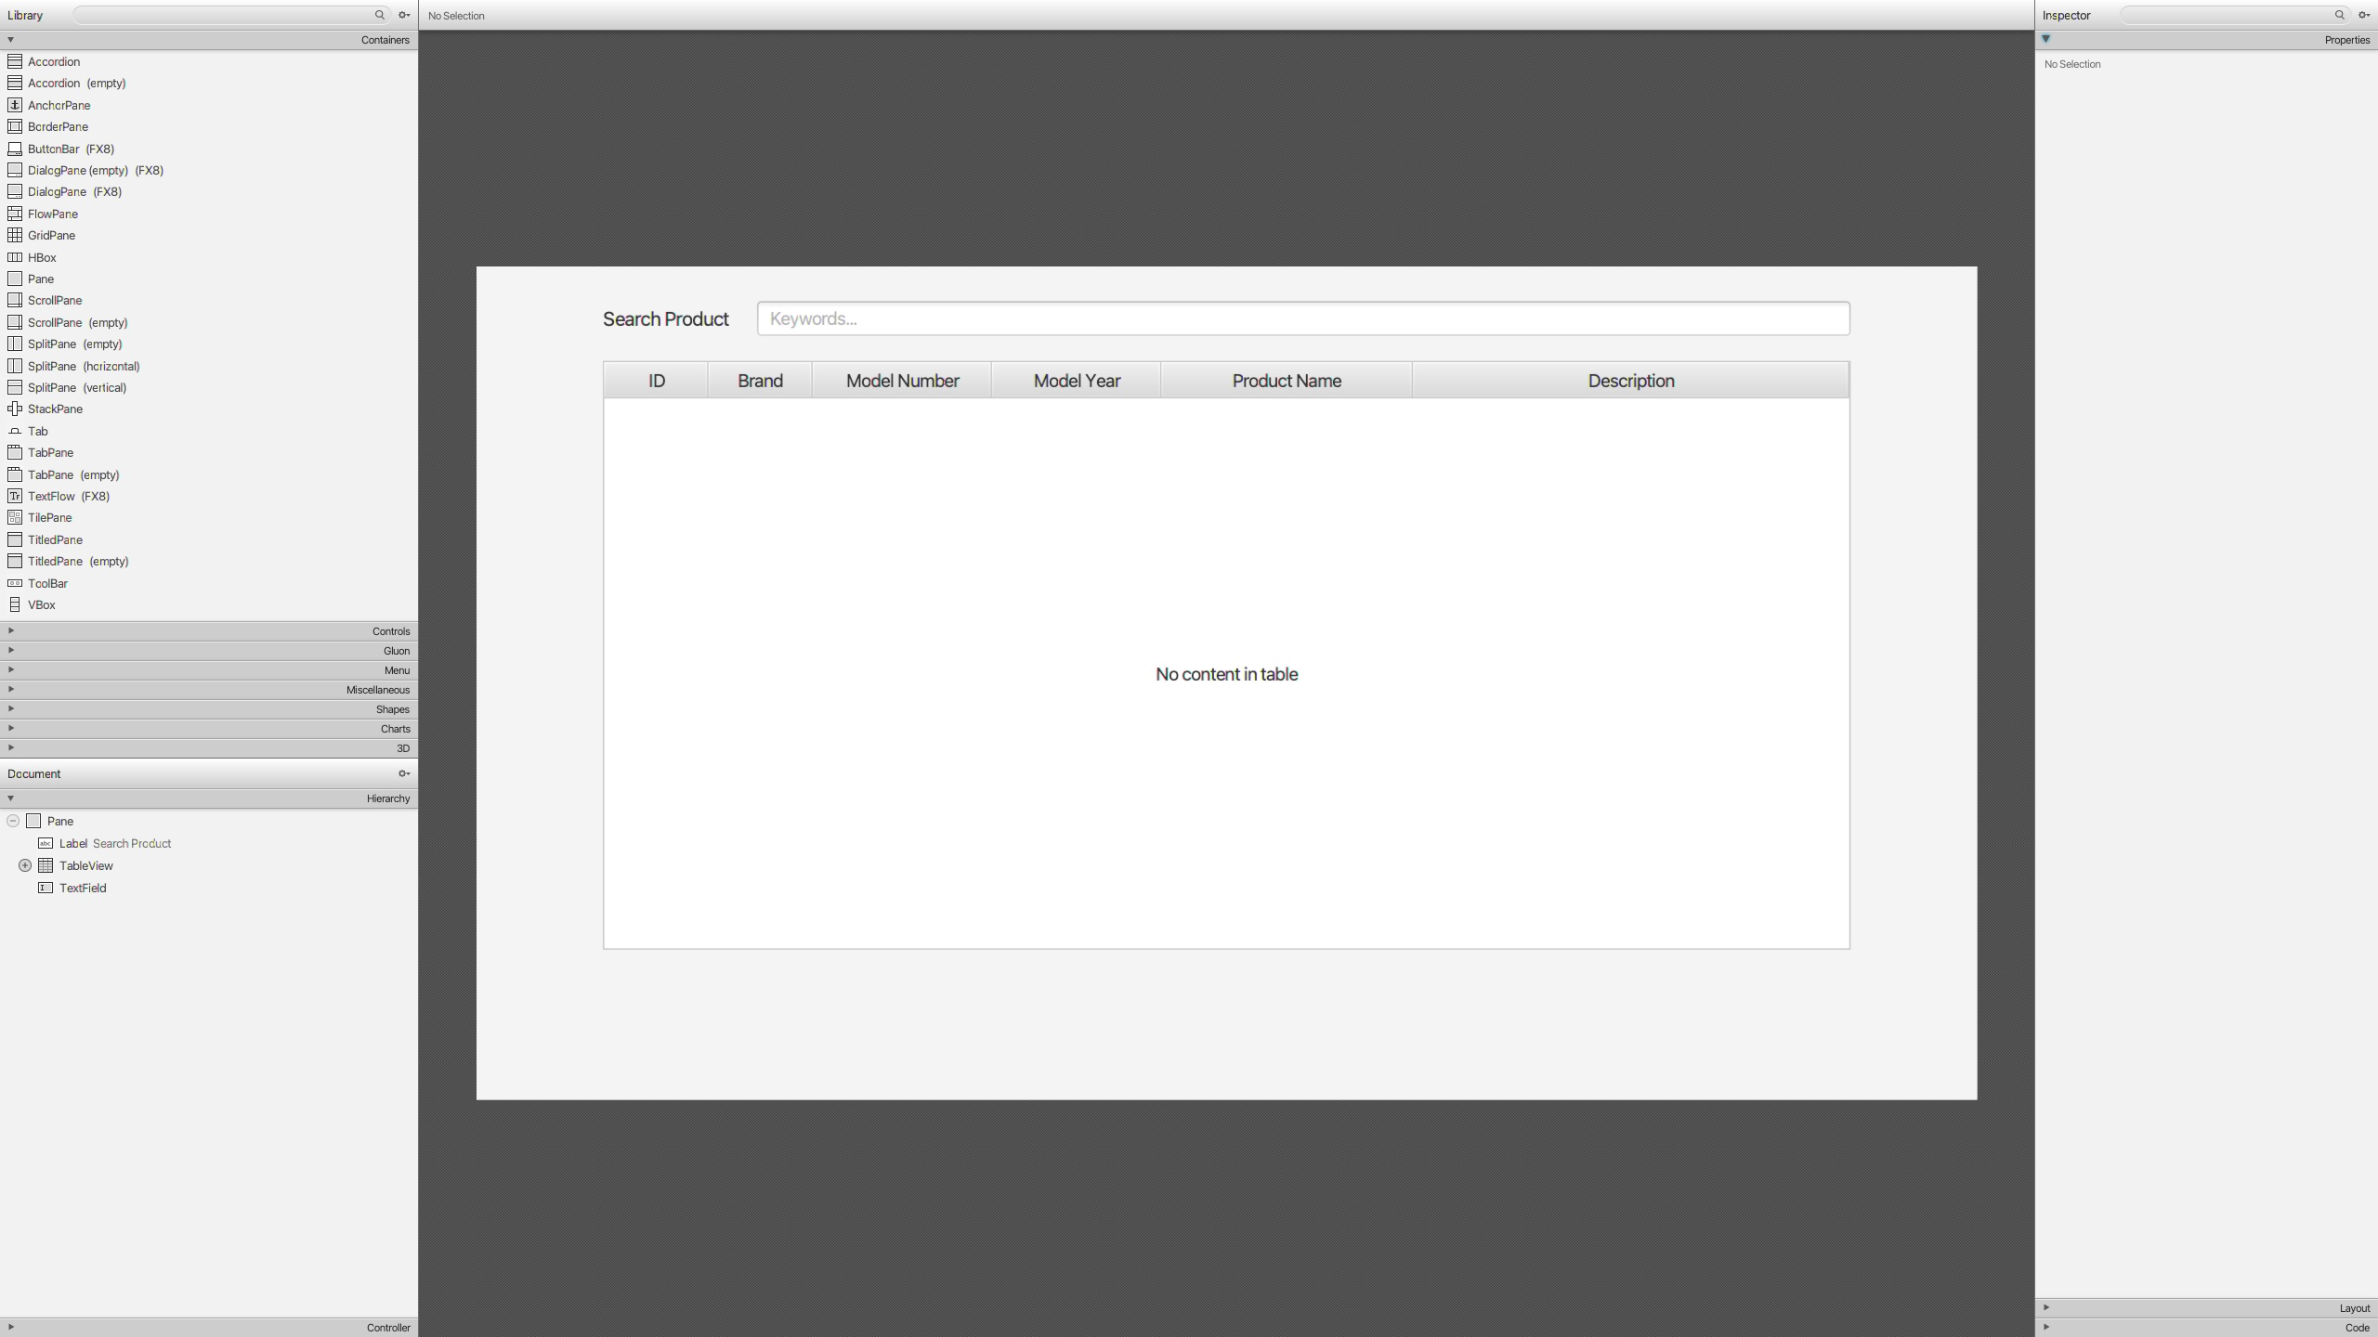
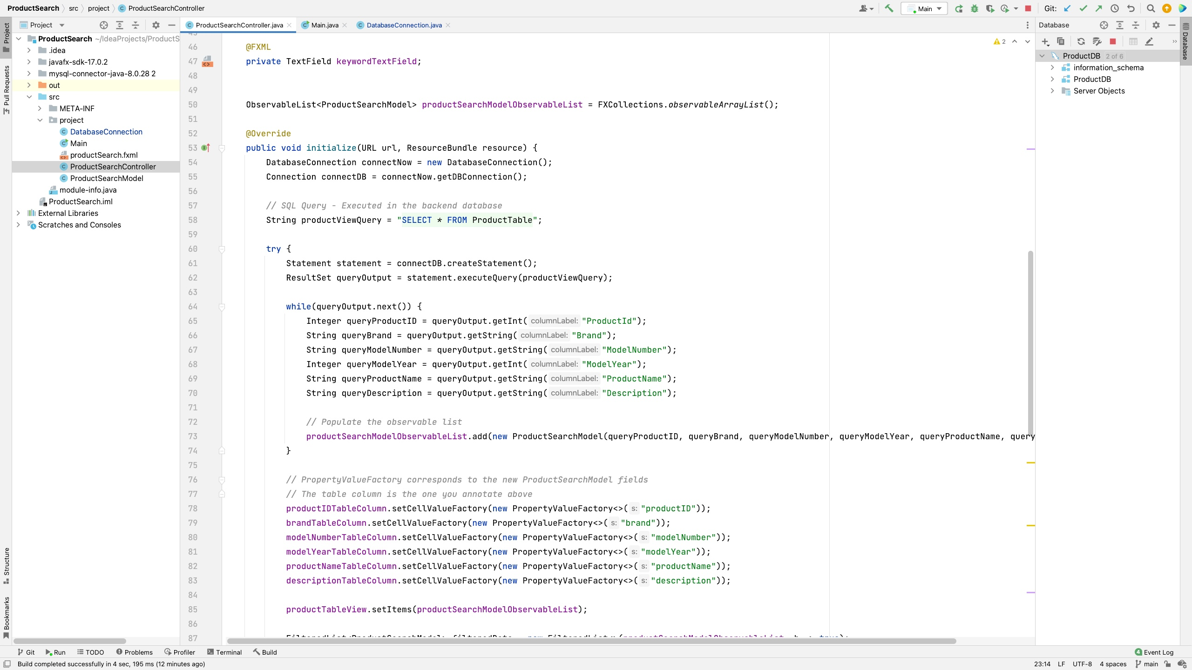
SCREENSHOTS OF CODE AND APP IN ACTION
1. Product Search Database Application
2. Search product by year
3. Scene Builder
4. Intelij IDEA

Slide 22
CONCLUSION
Our app works as expected. The running time is analyzed in detail.
The project finished successfully.

Slide 23
Thank you

